Slide 1
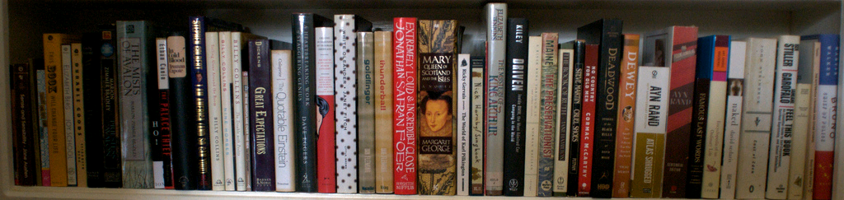

Welcome to Reynolds Library
image from Flickr User eloquentlight's photostream
http://library.reynolds.edu

Slide 2
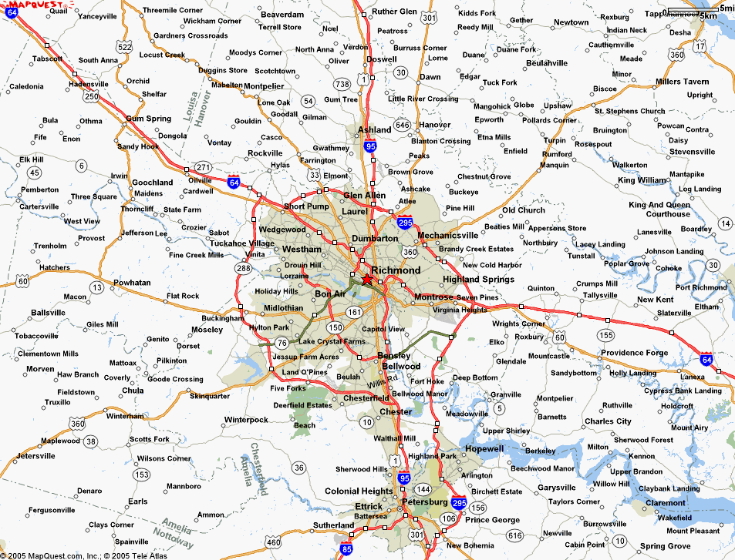
Where can you find us?
http://library.reynolds.edu
Goochland
Parham
Downtown

Slide 3
What do we have for you?
Books
Periodicals
Videos
Audio Books
Print: 90,000
Online: 40,000
Print: 597
DVDs: 3250
Online: 1000
Disc: 700
Online: 8750
Online: 50,000
Other Collections:
ESL
Career
Juvenile
Graphic
Educational & Popular
Notes:
According to the survey conducted by OCLC….

Slide 4
Books
Total: 130,000
Sign up for eBooks 101
workshop to learn more about reading and downloading ebooks …

Slide 5
eBooks Highlights
over 100 dictionary, language and subject reference works
About 1,500 encyclopedias and specialized reference sources
Over 13,500 eBooks on business and technology
Over 17,000 eBooks in a variety of subject areas
Over 2,000 titles on behavioral, biomedical, computer & environmental sciences
700 titles from Elsevier’s 2013 collection of science, technology and medicine

Slide 6
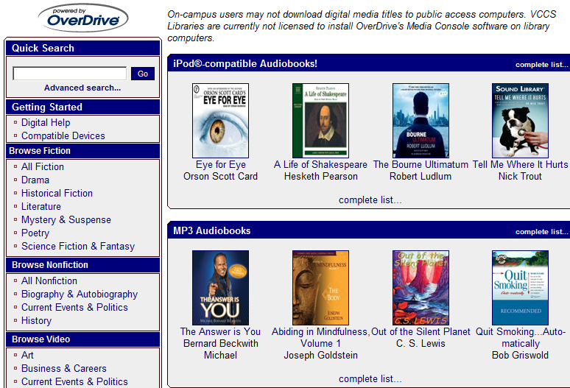
Audio Books: Online & Discs
Over 1000 online audio books with OverDrive and about 700 books on Discs

Slide 7

Videos: Streaming & DVD
Over 3,000 popular DVDs

Slide 8
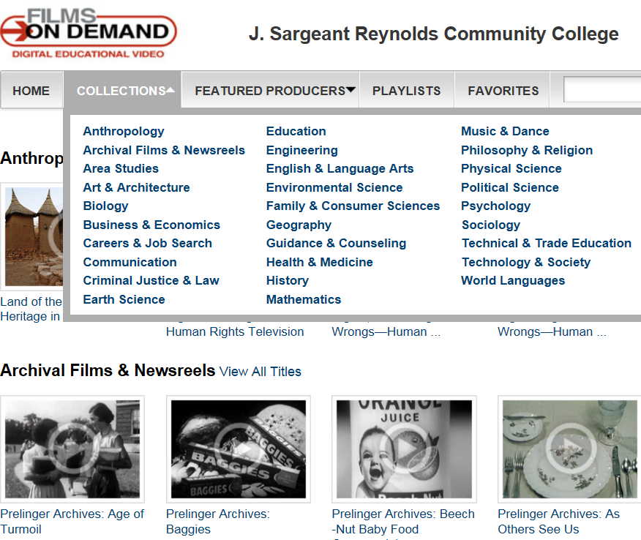
Videos: Streaming & DVD
Over 8,000 streaming documentaries from Films on Demand

Slide 9
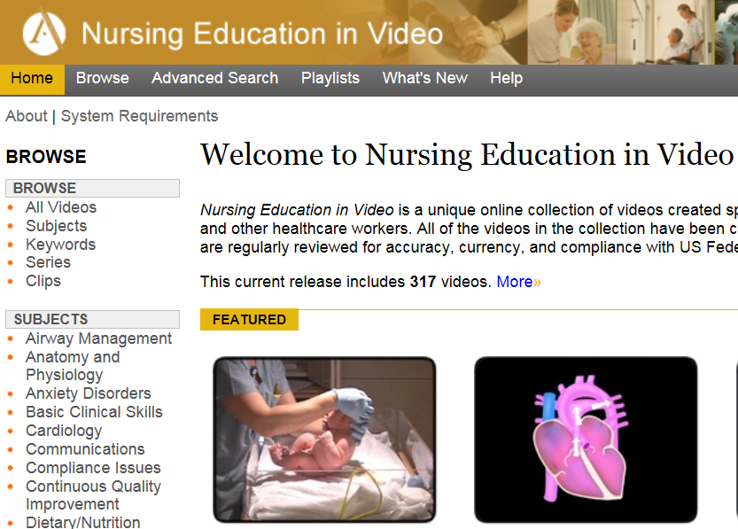
Videos: Streaming & DVD

Slide 10
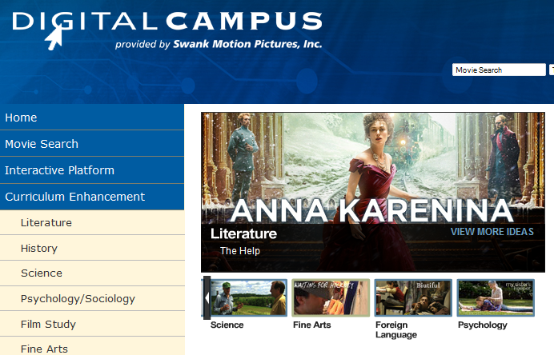
Videos: Streaming & DVD
Request a streaming feature film from Swank Motion Pictures to be delivered through Bb

Slide 11
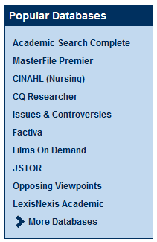
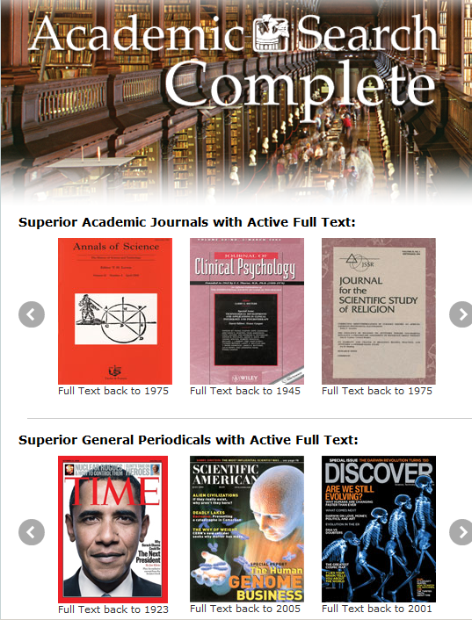

Periodicals

Slide 12
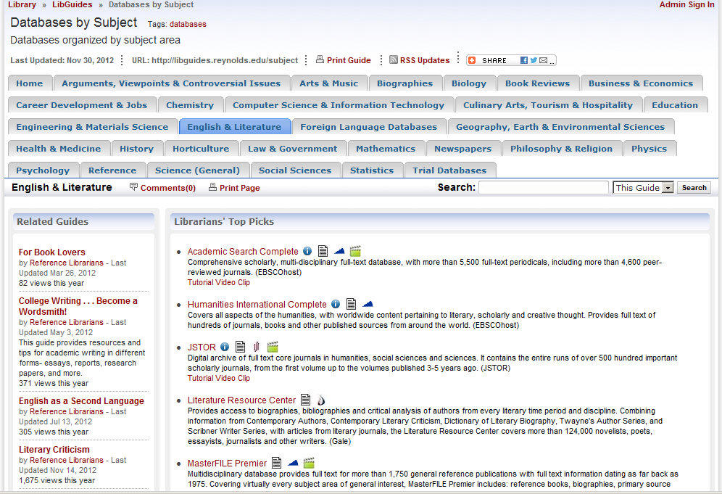
Databases

Slide 13

Reminder:
You can access our online resources 24/7 from both on- and off-campus
“MyJSRCC” login is your key to enter our online databases from off-campus
Attend Beyond the Textbook: Integrating Library Resources into Blackboard workshop to learn how to link online articles, ebooks or videos from Blackboard
Notes:
Image: http://www.123rf.com/photo_364562_around-the-clock.html
http://www.123rf.com/photo_1438015_gold-key-under-sun.html
Photo credit: http://www.onemedical.com/bos/how-we-work

Slide 14
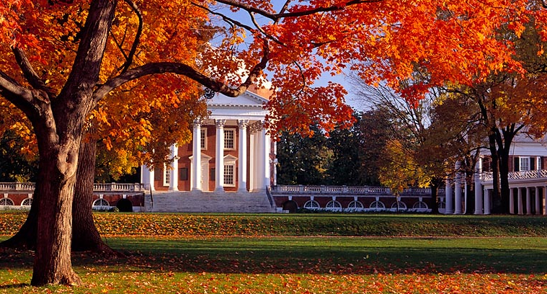
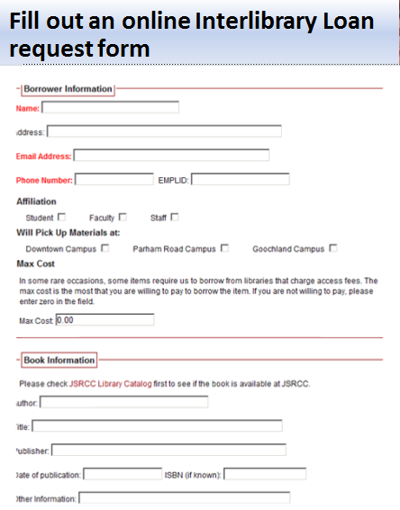

Beyond the Library…

Slide 15

What can we do for you?
ACRL Information Literacy Standards
F2F
Open Session Library Workshops
Customized Library Instruction
Online
LibGuides
Research at Reynolds Libraries
Assessment
Notes:
Photo: http://ascplcl.wordpress.com/parents-and-educators/information-literacy-resources/

Slide 16
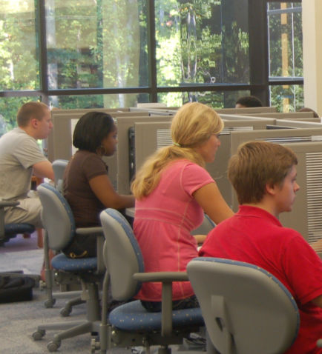
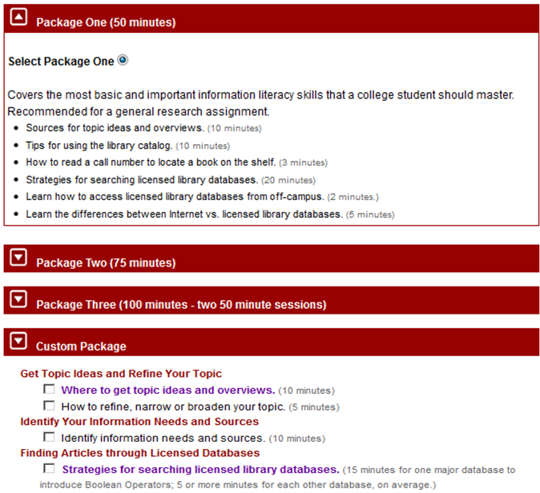
Customized Library Instruction Packages

Slide 17
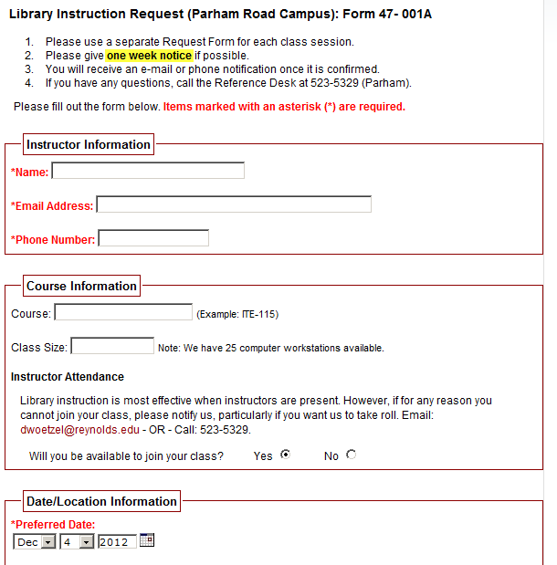
Customized Library Instruction Request

Slide 18
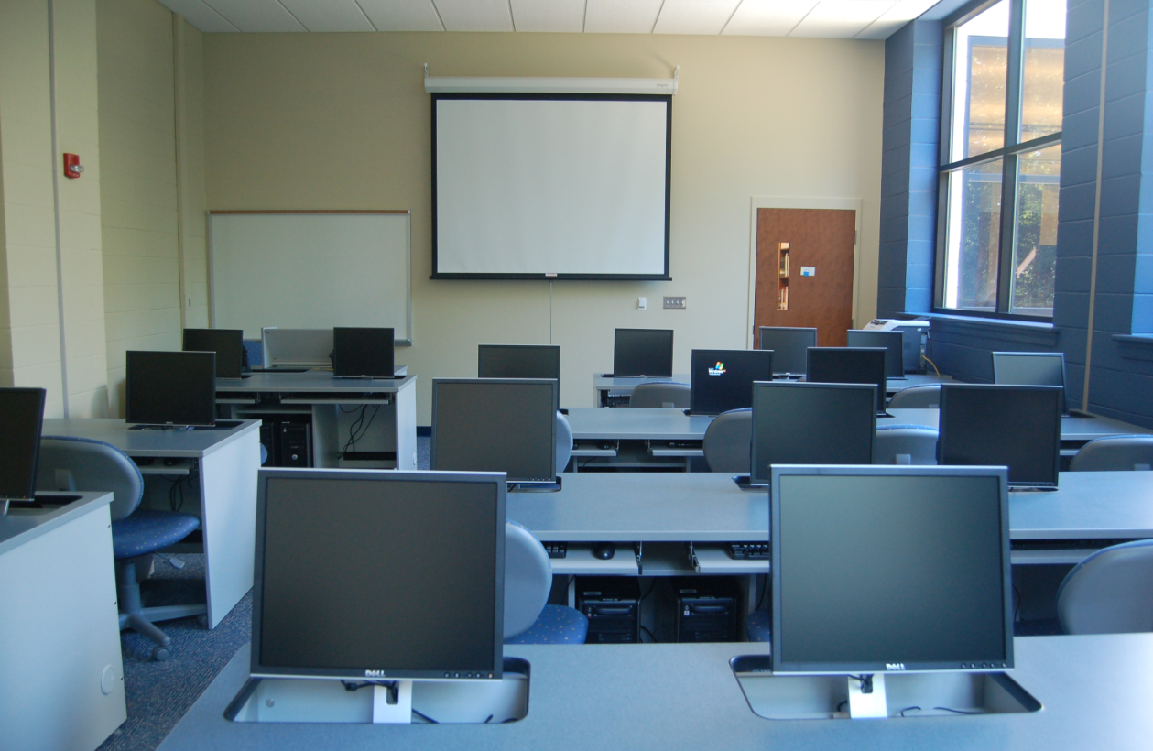
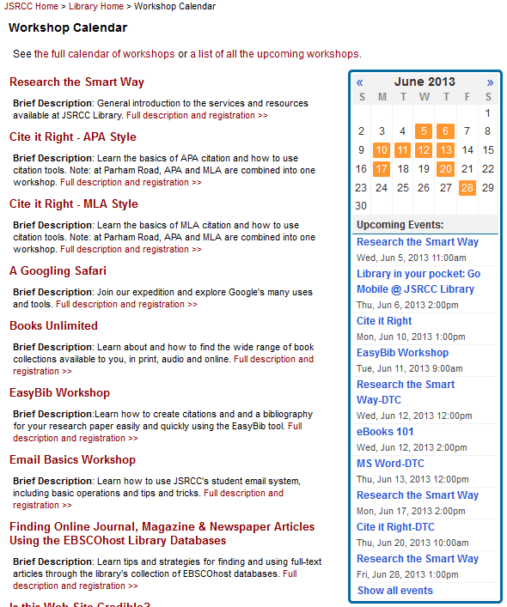
Open Session Library Workshops

Slide 19
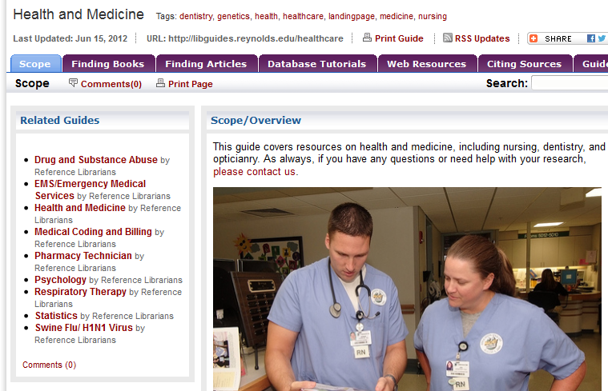
Course/Assignment/Subject-based LibGuides

Slide 20
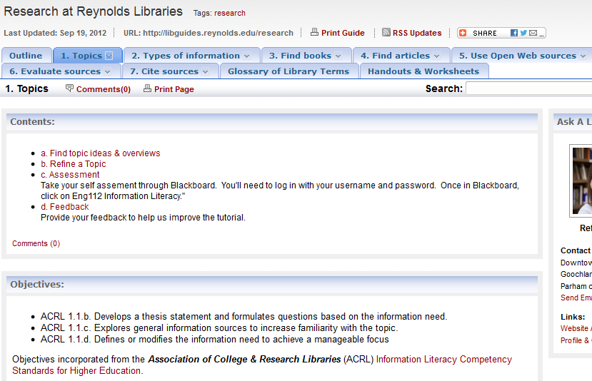
Research at Reynolds Libraries Online Modules

Slide 21
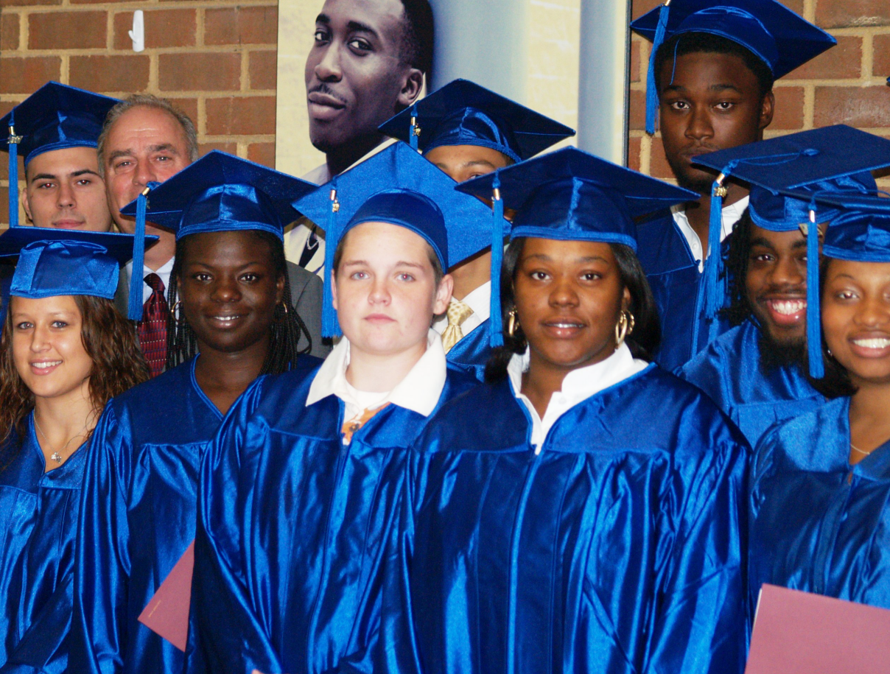
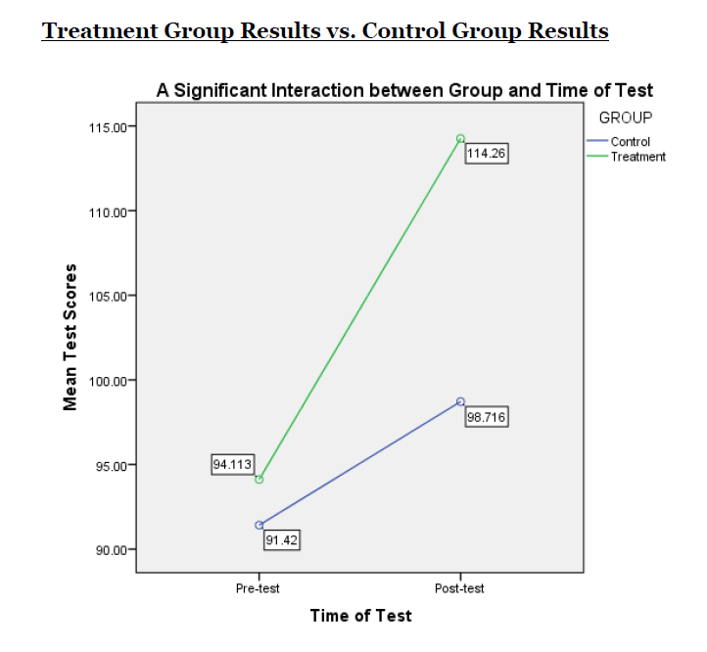
Impact of Integration of Online Modules

Slide 22
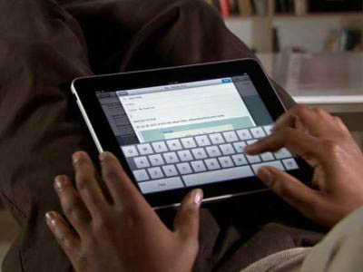
Testimony from a student…
Hey Mr. JSRCC Instructor,
Just wanted to let you know that at JMU we had to take a information skills test and go through all of these modules. I didn't even have to go through any of the modules because we already did basically the same thing in your class this spring. Passed with scores of 4,4,5,4 and 4 out of 5.
Thanks!!!!!!!!
Former JSRCC Student
Notes:
Photo:http://www.businessinsider.com/all-time-top-10-free-ipad-apps-2011-1?op=1

Slide 23
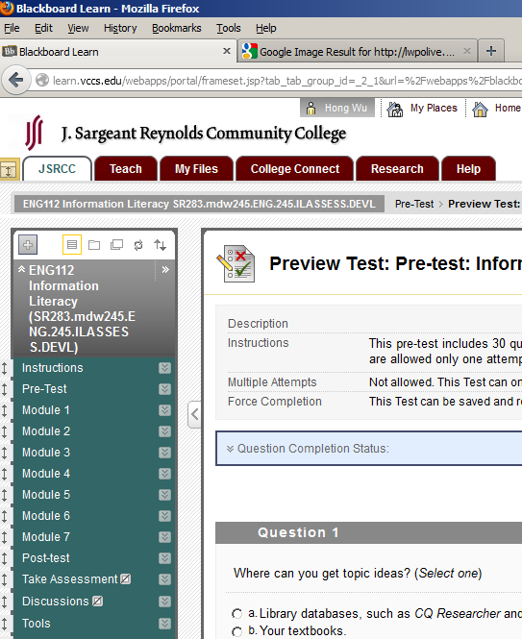
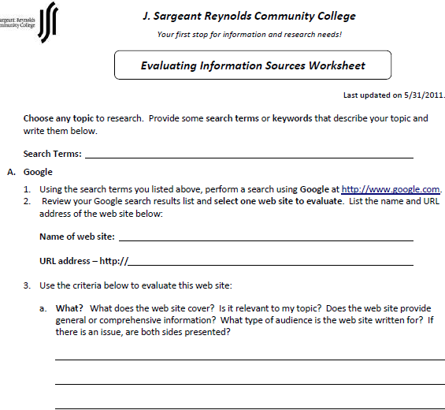
Information Literacy Assessment
Multiple Choice Questions via Bb
Open-ended Questions via Worksheets

Slide 24
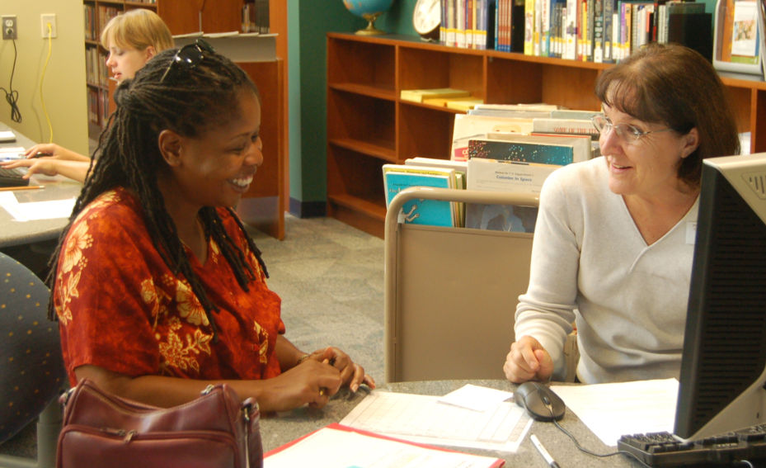
More from us…
Professional Development Opportunities (PDO)
Beyond the Textbook: Integrating Library Resources into Your Blackboard Courses
Library in your Pocket: Go Mobile @ JSRCC Library
eBooks 101
EasyBib
Googling Safari
One on One Research Consultation
Group Study Rooms for collaborative projects

Slide 25

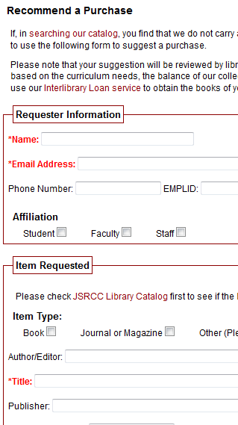
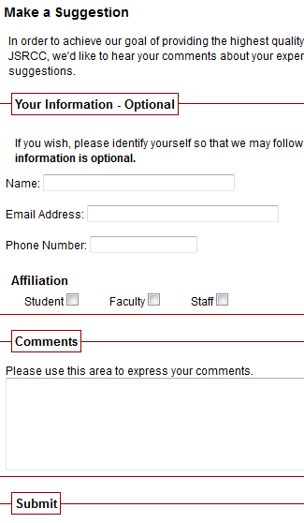
We welcome your feedback!
Notes:
Photo:http://www.kinesissurvey.com/kinesis-survey/customer-employee-feedback/

Slide 26

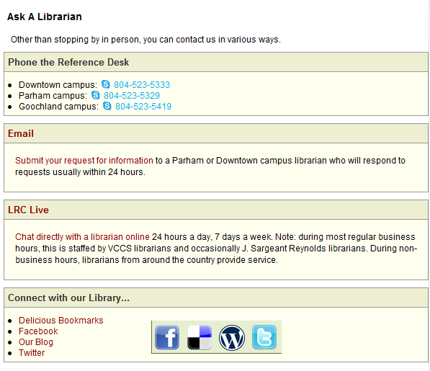
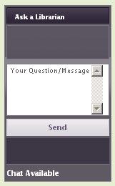
How to stay connected with us?

Slide 27
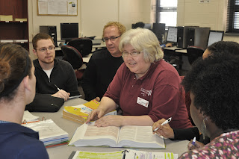
What can you do to help us?
If you have a special assignment that needs a special collection, discuss it with a librarian first.
Submit your library instruction request at least one week in advance.
Fill out the Assignment Alert form.
Put a copy of your textbook or required reading on Reserve.
Create assignments that would require your students to use library resources.
Contact a library liaison for collaborative projects…

Slide 28


Library Liaisons
Denise Woetzel (dwoetzel@reynolds.edu)
School of the Humanities, Social Sciences & Education
Khalil Ahmed (kahmed@reynolds.edu)
School of Nursing & Allied Health:
Kimberley Carroll (KCarroll@reynolds.edu)
Maureen Hady (mhady@reynolds.edu)
School of Business & Engineering
Susan Sherry (ssherry@reynolds.edu)
School of Mathematics & Sciences

Slide 29
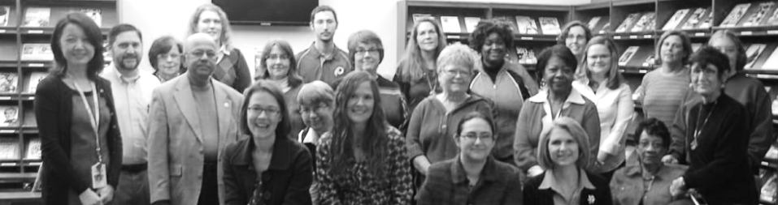
Thank You!
image from Flickr User eloquentlight's photostream
We are looking forward to working with you!
http://library.reynolds.edu

